Slide 1

Daniel John Keefer
Portfolio Presentation
Find it at: www.danielkeefer.com

Slide 2
Overview & Sitemap

Slide 3
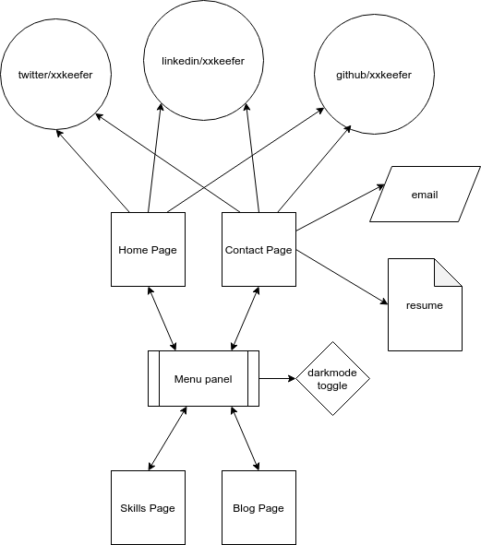
Keep it Simple...
Hamburger Menu
Menu take you anywhere
External links on home & contact pages

Slide 4
Wire Frames

Slide 5
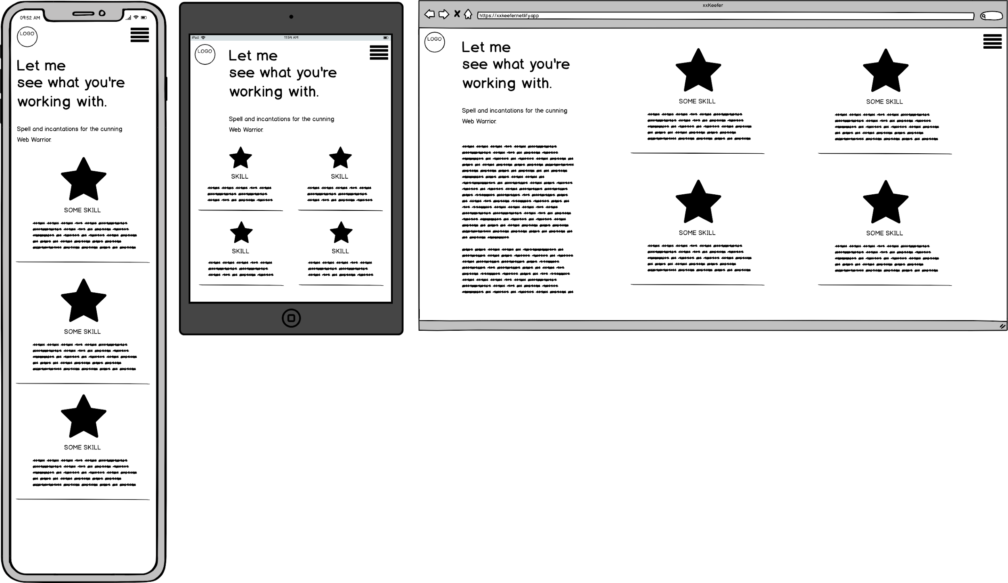
Simple design - repeated at different scales

Slide 6
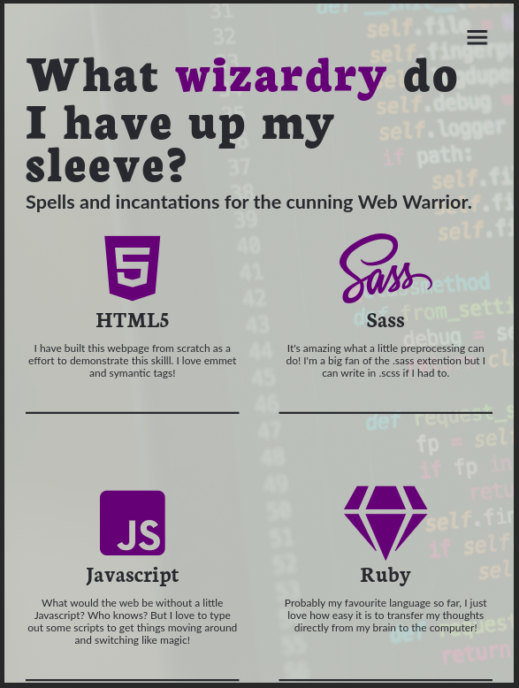
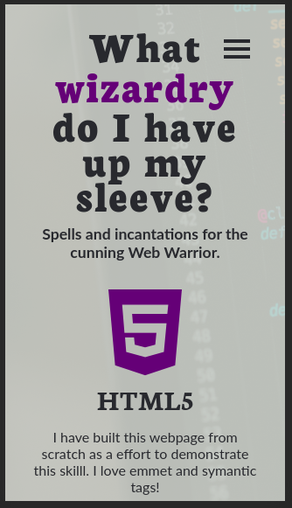
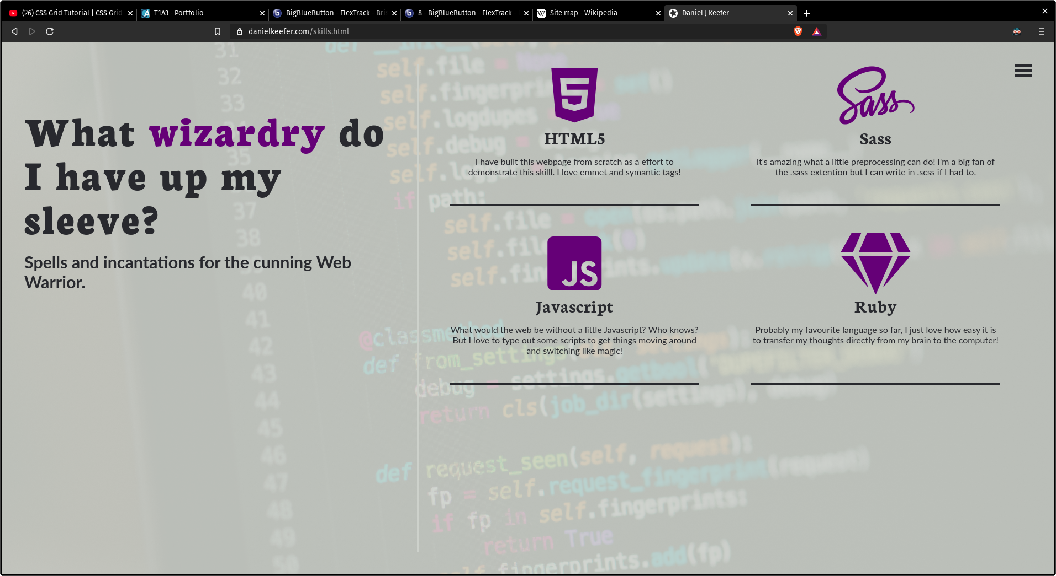
Simple design - repeated at different scales

Slide 7
Page Components
Sugar and spice and Javascript....

Slide 8
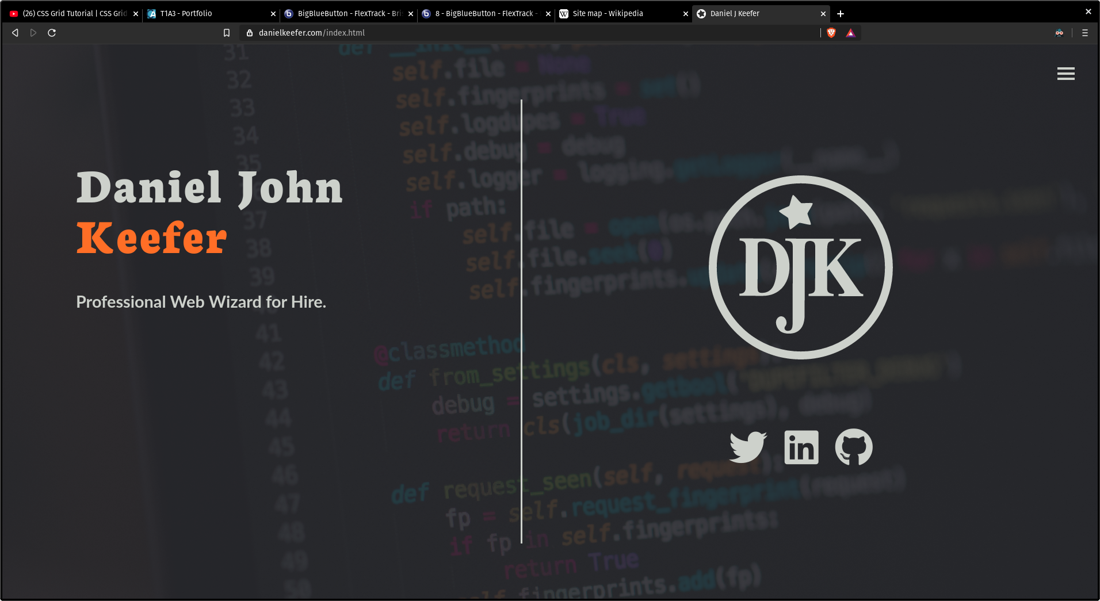
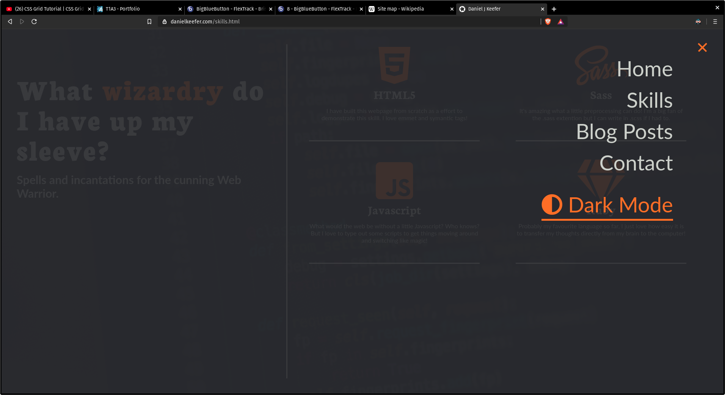
Hamburger Menu
Universally Recognised
Kind of boring
Using Js to add and remove a class of “.show” to my nav tag combined with the magic of css animations lets my menu slide in and out
This gives more screen real estate for me to show content I care about but gives users an easy cta for navigation.

Slide 9
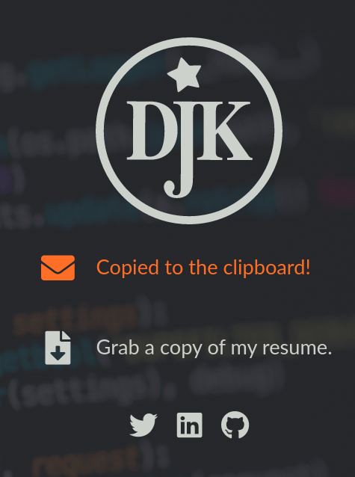
Clipboard API
Easy for user
Not supported across all browsers
Given the scope of of the project, I only focused on the browser I use (Chromium based browsers).
Clipboard API lets me ask & gain permission to write to a users clipboard. So they only have to CTRL+V into their email app.

Slide 10
Darkmode & localStorage
Remember’s user preference even after refresh
Allows user to choose a Light Theme, which should be discouraged at all costs.
Giving user an option between light and dark theme could potentially save battery on devices.
localStorage is a modern browser feature allowing devs to save a hash.

Slide 11
Thanks for your time.

